Slide 1


Database Project
Internet Forums

Slide 2
Students:
Under Supervision Of:
Yahia Quolquela
Amir Wagih Mofed
Dr. Yasser Ibrahim

Slide 3
But what are forums anyway??
An internet forum is a way for people to share their thoughts and ideas in a form of a posted messages (called “Posts” for shorts)
Each thread/topic can contain many posts
Each thread is part of a bigger sub-board and each sub-board is contained in a board containing many sub-boards

Slide 4
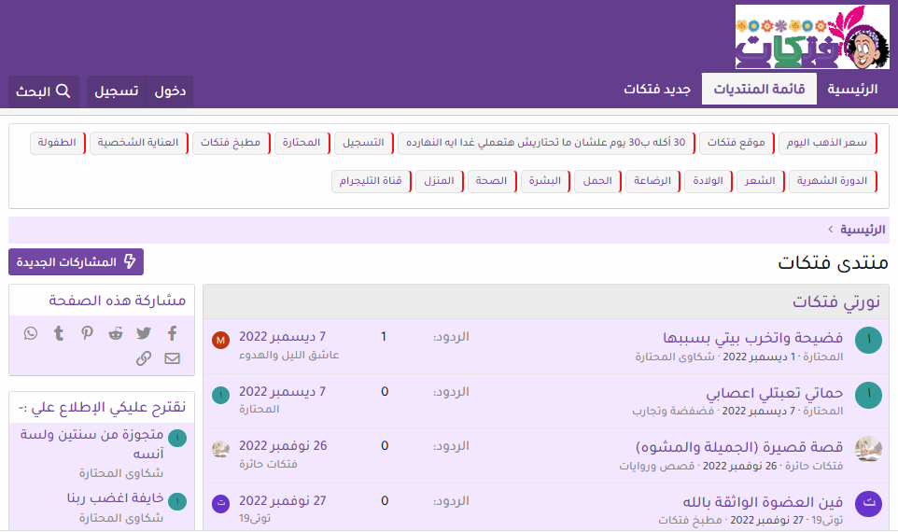

Slide 5
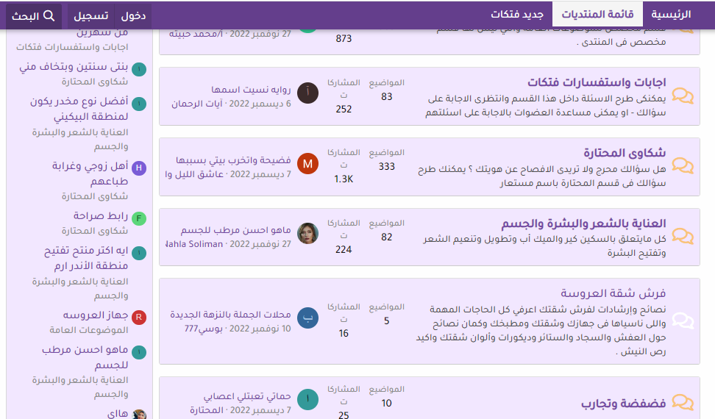

Slide 6
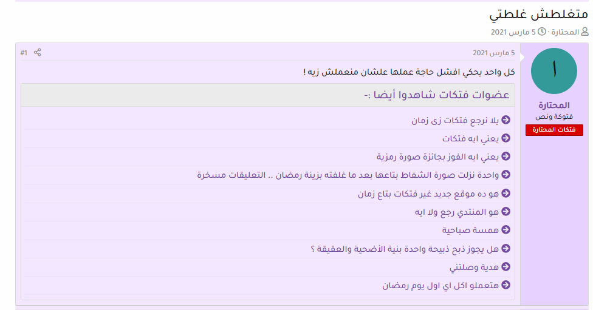


Slide 7
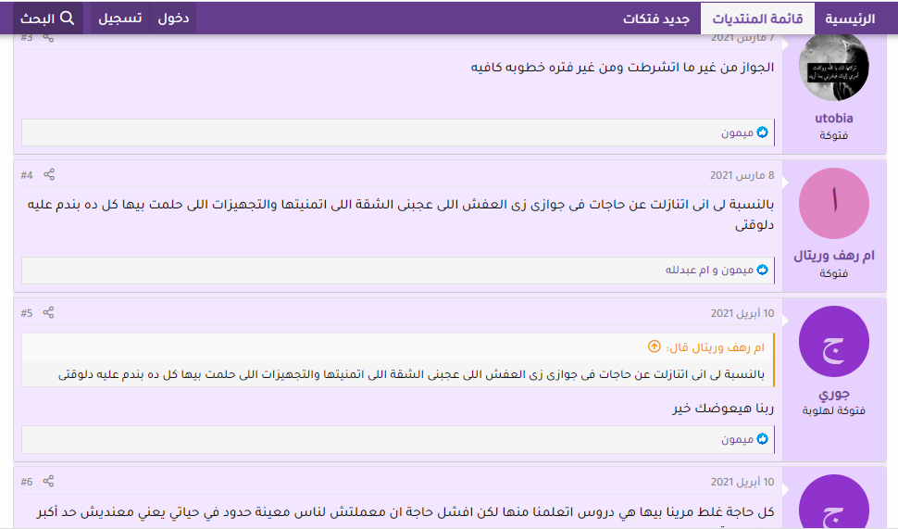






Slide 8
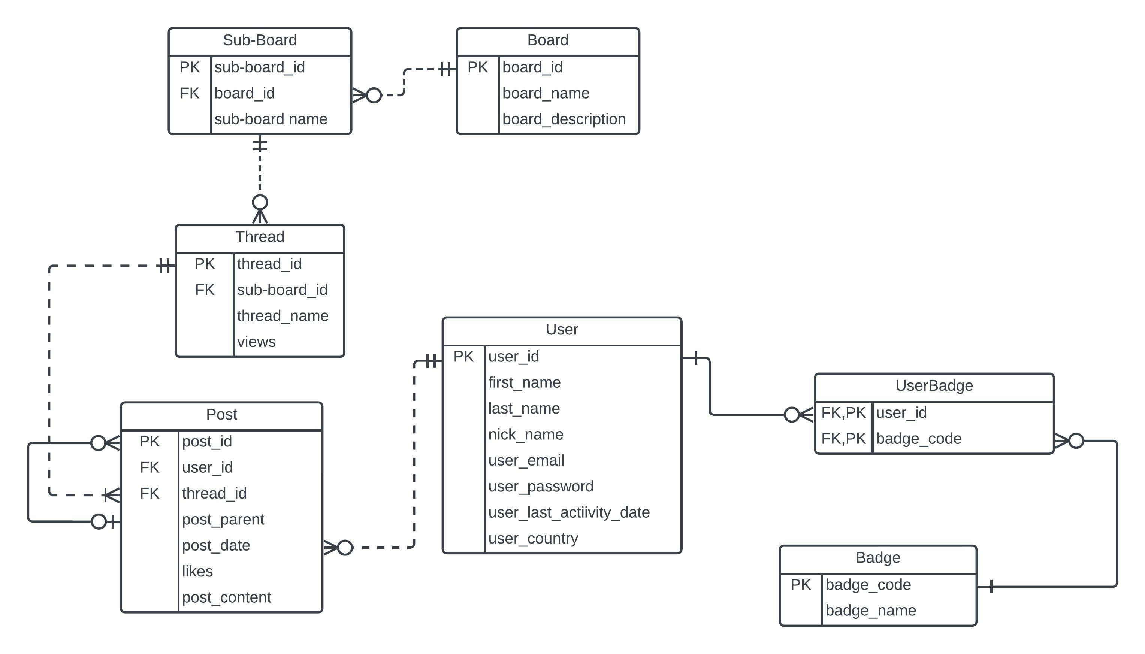
Forum Database Schema

Slide 9
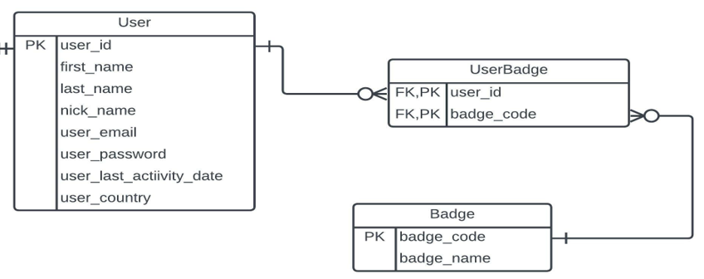
Creating Tables Using Access (SQL)
CREATE TABLE Badge
([Badge Code] INTEGER PRIMARY KEY,
[Badge Name] TEXT(20) NOT NULL);
CREATE TABLE User
([User ID] INTEGER PRIMARY KEY,
[First Name] TEXT(20) NOT NULL,
[Last Name] TEXT(20) NOT NULL,
[Nick Name] TEXT(20),
Email TEXT(50) NOT NULL,
Password TEXT(50) NOT NULL,
[User Last activity date] DATETIME NOT NULL,
Country TEXT(20) NOT NULL);

Slide 10
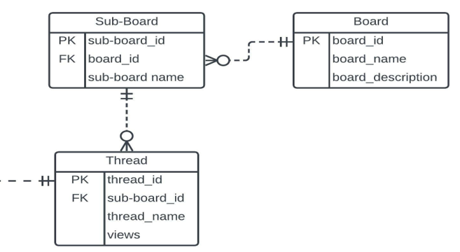
Creating Tables Using Access (SQL)
CREATE TABLE [User Badge]
([User ID] INTEGER CONSTRAINT REFuser REFERENCES User ([User ID]),
[Badge Code] INTEGER CONSTRAINT REFbadge REFERENCES Badge ([Badge Code]),
CONSTRAINT PKuserbadge PRIMARY KEY ([User ID],[Badge Code]));
CREATE TABLE BOARD
([Board ID] INTEGER PRIMARY KEY,
[Board Name] TEXT(50) NOT NULL,
[Board Description] TEXT);

Slide 11
Creating Tables Using Access (SQL)
CREATE TABLE [Sub-Board]
([Sub ID] INTEGER PRIMARY KEY,
[Board ID] INTEGER NOT NULL CONSTRAINT FKboardID
REFERENCES Board ([Board ID]),
Name Text(50) NOT NULL);
CREATE TABLE Thread
([Thread ID] INTEGER PRIMARY KEY,
[Sub-Board ID] INTEGER NOT NULL CONSTRAINT Fkboard
REFERENCES [Sub-Board] ([Sub ID]),
Name TEXT NOT NULL,
Views INTEGER NOT NULL);

Slide 12
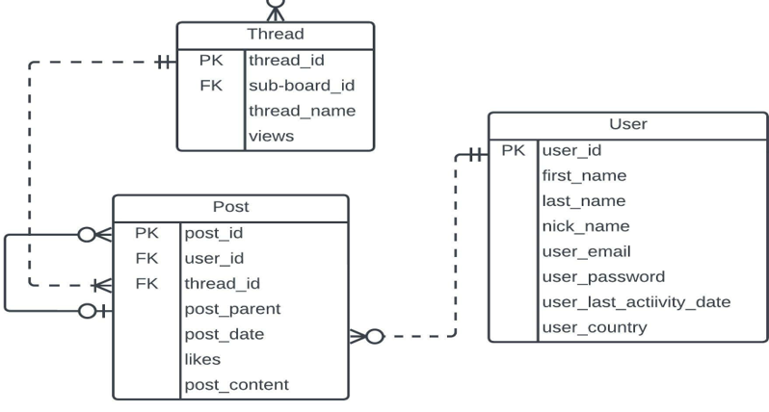
Creating Tables Using Access (SQL)
CREATE TABLE Post
([Post ID] INTEGER PRIMARY KEY,
[User ID] INTEGER NOT NULL CONSTRAINT FKuser
REFERENCES User ([User ID]),
[Thread ID] INTEGER NOT NULL CONSTRAINT FKthreadID
REFERENCES Thread ([Thread ID]),
[Post Parent] INTEGER CONSTRAINT FKParent REFERENCES
Post ([Post ID]),
[Post Date] DATETIME NOT NULL,
[Post Content] MEMO NOT NULL,
Like INTEGER NOT NULL);

Slide 13
Inserting Data Into Tables Using Access (SQL)
INSERT INTO [User]
VALUES (1, 'Ibrahim', 'Mertgen', 'nulla', 'imertgen0@shop-pro.jp', 'DHLnoyxCnd', #12/20/2022 8:55:00 AM#, 'Sweden');
INSERT INTO Badge
SELECT *
FROM [Badge data];

Slide 14
Inserting Data Into Tables Using Access (SQL)
INSERT INTO [User]
SELECT *
FROM [User data];
INSERT INTO [Sub-Board]
SELECT *
FROM [SUB-board data];
INSERT INTO [User Badge]
SELECT *
FROM [User Badge data];
INSERT INTO Thread
SELECT *
FROM [Thread data];
INSERT INTO Board
SELECT *
FROM [Board data];
INSERT INTO Post
SELECT *
FROM [Post data];

Slide 15
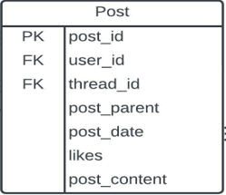
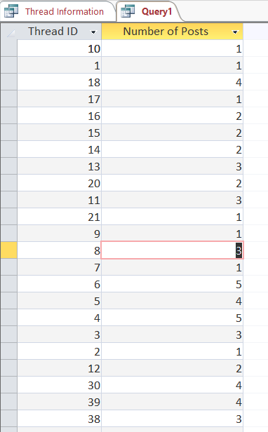
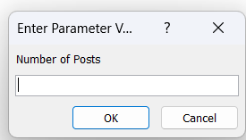
Get number of posts for each thread
SELECT [Thread ID], COUNT(*) AS [Number of Posts]
FROM POST
GROUP BY [Thread ID]
ORDER BY [Number of Posts] DESC;

Slide 16
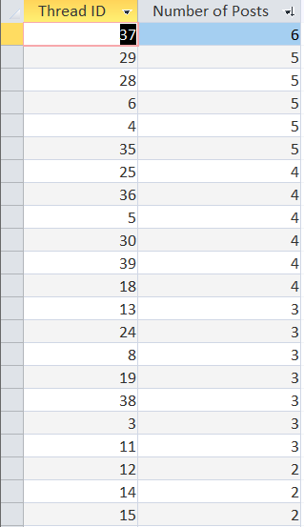
Get number of posts for each thread
SELECT *
FROM (SELECT [Thread ID], COUNT(*) AS [Number of Posts]
FROM POST
GROUP BY [Thread ID]) AS A
ORDER BY A.[Number of Posts] DESC;

Slide 17
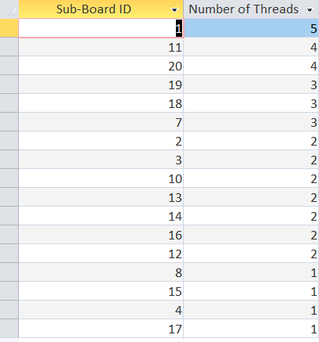
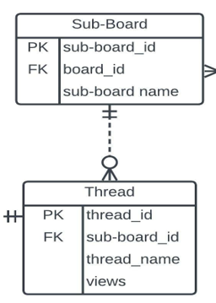
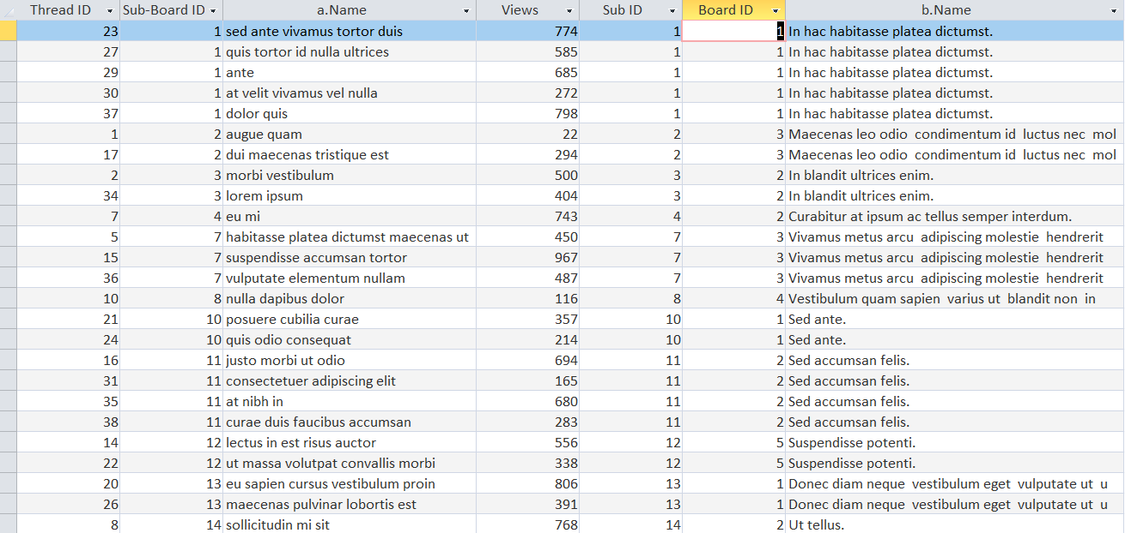
Get number of threads in each subboard
SELECT * FROM
(SELECT c.[Sub-Board ID], COUNT(*) AS [Number of Threads] FROM
(SELECT * FROM Thread AS a INNER JOIN [Sub-Board] AS b ON a.[Sub-Board ID] = b.[Sub ID]) AS c
GROUP BY c.[Sub-Board ID])
ORDER BY [Number of Threads] DESC;

Slide 18
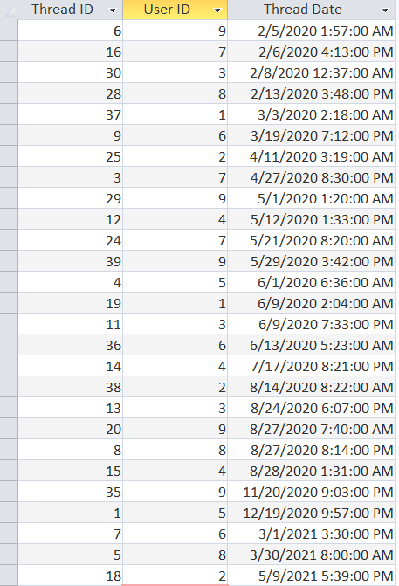
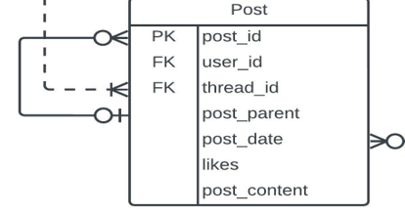
Get Users who created each thread
SELECT p1.[Thread ID], p2.[User ID], p1.[Thread Date]
FROM
(SELECT [Thread ID], MIN([Post Date]) AS [Thread Date] FROM POST GROUP BY [Thread ID]) AS p1
INNER JOIN
POST AS p2 ON (p1.[Thread ID] = p2.[Thread ID]) AND (p1.[Thread Date] = p2.[Post Date]);

Slide 19

Get Thread Information

Slide 20
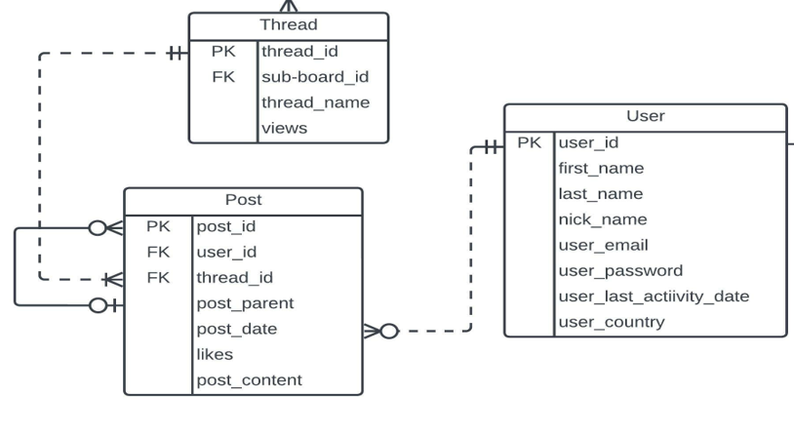
Get Thread Information
SELECT B.Name AS [Thread Name], IIF(D.[Nick Name] IS NULL, D.[Last Name], D.[Nick Name]) AS Author, B.Views, A.Replies,A.Activity
FROM
(((SELECT [Thread ID], Count(*) AS [Number of Posts], ([Number of Posts]-1) AS Replies,
MAX([Post Date]) AS NDate, DATEDIFF('h', NDate, Date()) AS Activity,
MIN([Post Date]) AS [Thread Date]
FROM Post
GROUP BY [Thread ID]) AS A
INNER JOIN Thread AS B
ON A.[Thread ID] = B.[Thread ID])
INNER JOIN Post AS C
ON C.[Thread ID] = A.[Thread ID] AND C.[Post Date] = A.[Thread Date])
INNER JOIN User AS D
ON C.[User ID] = D.[User ID]
ORDER BY Activity ASC;

Slide 21
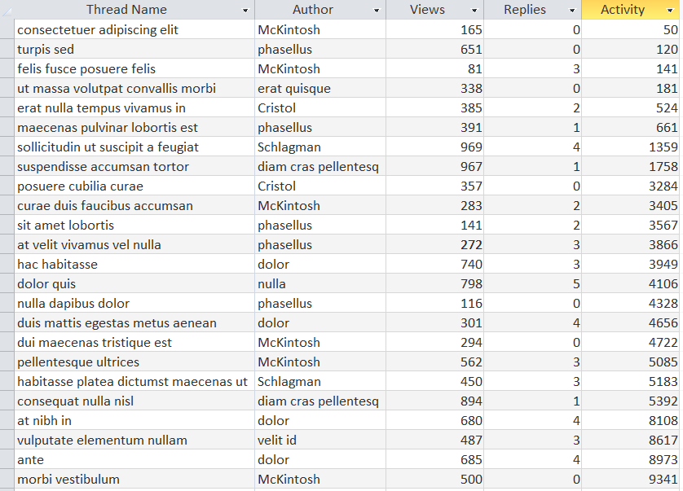
Get Thread Information

Slide 22
Text Mining
Get The Most Viewed Thread or Most Liked Comments (Posts)
Use STRING_SPLIT Function (Separates sentences into its words)
Helps in identifying meaningful patterns and new insights

Slide 23
Conclusions

Slide 24
THANK YOU

